Slide 1
Session-08
Week / Session 08
Namrata Aneja
ICT40518 Certificate IV in Programming
Data Driven Applications
ICTPRG431 | Apply Query Language
ICTPRG432 | Develop Data Driven Applications

Slide 2
Session Contents
View Tables
Create View
Update View
Delete View

Slide 3
What is a VIEW in SQL
Views in SQL are kind of virtual tables. A view also has rows and columns as they are in a real table in the database. We can create a view by selecting fields from one or more tables present in the database. A View can either have all the rows of a table or specific rows based on certain condition.

Slide 4
Why to create a View table
A good database should contain views due to the given reasons:
Restricting data access – Views provide an additional level of table security by restricting access to a predetermined set of rows and columns of a table.
Hiding data complexity – A view can hide the complexity that exists in a multiple table join.
Simplify commands for the user – Views allows the user to select information from multiple tables without requiring the users to actually know how to perform a join.

Slide 5
Why to create a View table
4.Store complex queries – Views can be used to store complex queries.
5.Rename Columns – Views can also be used to rename the columns without affecting the base tables provided the number of columns in view must match the number of columns specified in select statement. Thus, renaming helps to hide the names of the columns of the base tables.
6.Multiple view facility – Different views can be created on the same table for different users.

Slide 6
Create View Using Computermart database created in Session 4 powerpoint presentation slide 19-25

Slide 7
Create View We can create View using CREATE VIEW statement. A View can be created from a single table or multiple tables.
SYNTAX FOR VIEW
CREATE VIEW view_name AS SELECT column1, column2..... FROM table_name WHERE condition;
view_name: Name for the View
table_name: Name of the table
condition: Condition to select rows

Slide 8
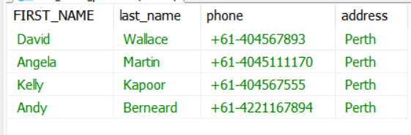
Try the given commands to create a view
USE computerMART;
CREATE VIEW cust_name_phone AS SELECT FIRST_NAME,last_name,phone,Address FROM customer
WHERE address='perth';
SELECT * FROM cust_name_phone;
Notes:
The above command creates a view table named cust_name_phone out of customer table which is part of computermart database. This is also called as a Virtual Table.
Sql permits application of commands like Insert, Delete and Update in the virtual table.
Sql does not allow commands like Alter table & Rename table on the view tables.

Slide 9
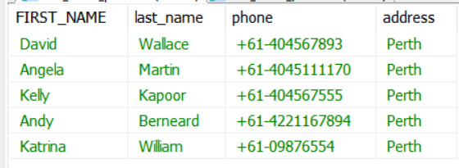
INSERT COMMAND IN VIEW TABLE
INSERT INTO cust_name_phone VALUES ('Katrina','William','+61-09876554', 'Perth');
SELECT * FROM cust_name_phone;
Notes:
However, If you try the command
INSERT INTO cust_name_phoneVALUES ('Tina','Martin','+61-09876554', 'Sydney’);
The above command will not insert any values in virtual table because the table was created on the condition of considering only Perth addresses.
Sql permits application of commands like Insert, Delete and Update in the virtual table.
Sql does not allow commands like Alter table, Rename table and drop table on the view tables.

Slide 10
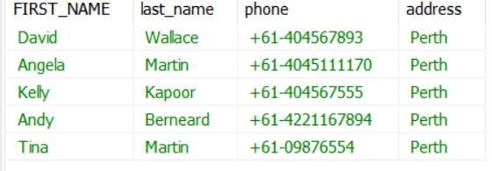
Delete Command on View table
DELETE FROM cust_name_phone where first_name='katrina';
SELECT * FROM cust_name_phone;
Notes:
Sql permits application of commands like Insert, Delete and Update in the virtual table.
Sql does not allow commands like Alter table & Rename table on the view tables.

Slide 11
Drop Command in View table
Drop view cust_name_phone1;
Deleting/dropping of view table is easy in SQL by using the above command
Notes:
Sql permits application of commands like Insert, Delete and Update in the virtual table.
Sql does not allow commands like Alter table & Rename table on the view tables.

Slide 12
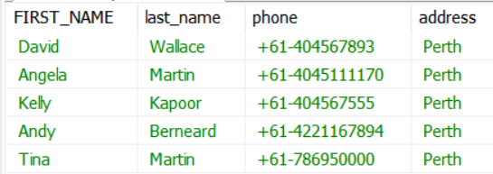
UPDATE Command in a virtual table
UPDATE cust_name_phone
Set phone= '+61-786950000'
where first_name='Tina';
Notes:
Sql permits application of commands like Insert, Delete and Update in the virtual table.
Sql does not allow commands like Alter table & Rename table on the view tables.

Slide 13
CREATE VIEW USING MULTIPLE TABLES or MORE THAN ONE TABLES
Session 7

Slide 14
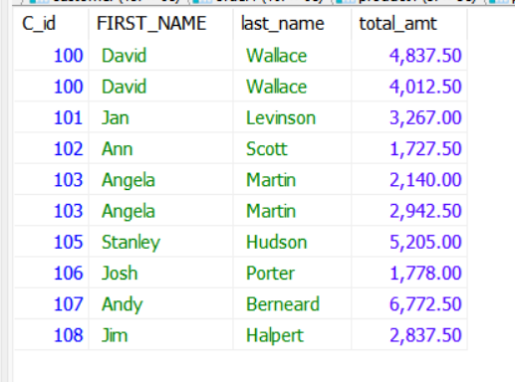
View with more than one table:
USE computerMART;
CREATE VIEW cust_order1 AS SELECT
order1.C_id, FIRST_NAME,last_name,total_amt
FROM customer, order
WHERE customer.C_id=order.C_id;
SELECT * FROM cust_order1;

Slide 15
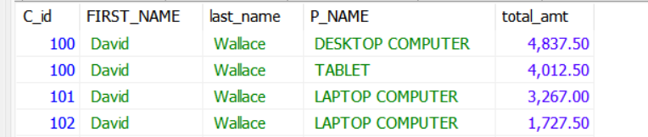
View with multiple tables
USE computerMART;
CREATE VIEW cust_order1 AS SELECT
order1.C_id, FIRST_NAME,last_name,P_NAME,total_amt
FROM customer,order,product
WHERE order1.P_id=product1.P_id;
SELECT * FROM cust_order1;

Slide 16
Excercise
Session 7

Slide 17
Query Exercises:
Practice view command in database Computermart using tables Customers,Orders,Order-products,Categories & Items in session 4.
Practice view command in database TAFE using tables
Students, Teachers, Books, Courses

Slide 18
Practices with practice exercises given in BB
References:-​
https://www.w3schools.com/SQL​
https://stackoverflow.com/questions​
https://www.programiz.com/sql/​
https://www.w3resource.com/​
https://www.microsoft.com/en-au/sql-server/sql-server​
https://en.wikipedia.org/wiki/SQL​
​

